Slide 1

Azure OpenAI Service

Slide 2
Agenda
Azure OpenAI Service Overview
Industry Examples and Reference Architectures
Responsible AI and content filtering details
Evaluating and integrating AOAI for your use
API Usage, SDK, Rate Limits & Model availability
Data Privacy & Security
Customer Examples

Slide 3
Generative AI
Artificial Intelligence
1956
Artificial Intelligence
the field of computer science that seeks to create intelligent machines that can replicate or exceed human intelligence
Machine Learning
1997
Machine Learning
subset of AI that enables machines to learn from existing data and improve upon that data to make decisions or predictions
Deep Learning
2017
Deep Learning
a machine learning technique in which layers of neural networks are used to process data and make decisions
2021
Generative AI
Create new written, visual, and auditory content given prompts or existing data.
Notes:
Narrative/talk track:
What is a brief history of artificial intelligence?
Artificial intelligence (AI) has a long and storied history that spans many decades. Some of the earliest work in AI was done in the 1950s and 1960s, when researchers first began to explore the possibility of creating machines that could "think" like humans.
During the 1950s and 1960s, AI research focused primarily on "symbolic" AI, which involved creating symbolic representations of knowledge and using them to solve problems. Researchers in this field developed early versions of what are now known as expert systems, which are computer programs that mimic the decision-making abilities of human experts in a specific domain.
In the 1970s and 1980s, AI research began to shift away from symbolic AI and towards "sub-symbolic" AI, which involves using statistical methods and mathematical models to solve problems. This shift was driven in part by the realization that symbolic AI was too complex and difficult to scale, and in part by the development of new computer hardware that made it possible to process large amounts of data quickly.
In the 1990s and 2000s, AI research continued to evolve, and new subfields began to emerge. One of these was "machine learning," which focuses on creating algorithms that allow computers to learn from data without being explicitly programmed. Another was "neural networks," which are mathematical models inspired by the structure and function of the human brain.
Recently, Generative Models like GPT-3 and DALL-E, Variational Autoencoders, Generative Adversarial Networks and many more have risen and continue to advance the field of AI. These models are able to generate new examples that are similar to examples from a given dataset. It is being used in diverse fields such as natural language processing, computer vision, speech recognition and many more.
Overall, AI has come a long way since its inception in the 1950s, and it continues to evolve and improve at a rapid pace today.
What is Generative AI and where does it fit into the scope of AI?
Generative AI is a subfield of Artificial Intelligence that focuses on creating systems that can generate new examples, such as images, text, or speech, that are similar to examples from a given dataset. The goal of generative AI is to develop algorithms that can learn the underlying probability distribution of a given dataset and use this knowledge to generate new examples that are similar to the examples in the dataset.
Generative AI models can be classified into two broad categories: generative models and discriminative models. Generative models such as GPT-3, DALL-E, Variational Autoencoders etc learns the underlying probability distribution of the dataset and can generate new examples from the learned distribution. Discriminative models, such as deep neural networks, learn to differentiate between different classes or categories, and are generally used for tasks such as image or speech recognition.
Generative AI sits on top of other areas of AI like unsupervised learning, supervised learning and reinforcement learning. It relies on the capability of those models to extract useful features from the data and use that for learning the underlying probability distribution of the data which is used for generthe potential to be used in a wide range of applications, such as computer vision, natural language processing, speech recognition, and many more.
ating new examples.
Overall, generative AI is a rapidly growing field within AI, and it has

Slide 4












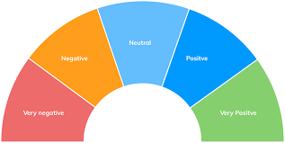


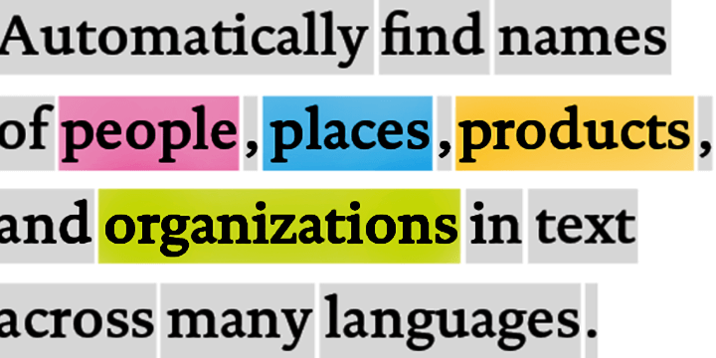
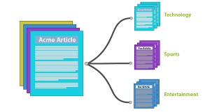








Traditional model development High cost and slow deployment—each service is trained disjointly
DEPLOYMENTS
Tagging Services
Spatial Analysis Services
Accessibility Services
Spatial Presenter
Azure Search, Video Indexer
EAGLE
EAGLE
FLOWER
PLAYING SOCCER
Classification
Object Detection
Object Tracking
Action Recognition
Entities
Topics
Sentiments
TASKS
Classification Model
Detection Model
Tracking Model
Action Model
Entity Recognition
Topic Classification
Sentiment Analysis
INDIVIDUAL MODEL (DISJOINTLY)
TRAINING DATA
(w/ ANNOTATION)
Tagging data
Detection data
Tracking data
Action data
Entity data
Topic data
Sentiment data
Notes:
(This and the next 9 slides help with the flow to move from the high-level to the deep dive)
The traditional approach of AI model development involves training a model on a very specific dataset with a specific task in-mind. For example, an entity recognition model requires specifically tagged entity data and a sentiment analysis model requires specifically trained sentiment data, which can be a bottleneck in training ML models. As a result, not only is a lot of tagged data required, but the data remains segmented for specific tasks, leading to higher development costs and slower deployments.

Slide 5














Foundation Models
Tasks
Question and Answering
Data
Sentiment Analysis
Text
Foundation Model
Information Extraction
Images
Speech
Training
Adaptation
Image Captioning
Structured Data
3d Signals
Transformer Model
Object Recognition
Instruction Follow
Notes:
The future of AI is models that are flexible, reusable and that can be applied to just about any domain or industry task.
Foundation models are at the heart of many of the latest breakthroughs. These models have been influential in the development of artificial intelligence systems, and have played a major role in changing how AI systems are constructed since their introduction in 2018.
A foundation model is a machine learning model that is trained on a large amount of unlabeled data, allowing it to be adapted to a wide variety of tasks. These models capture general patterns and structure of data, and aim to replace task-specific models by unifying different tasks and modalities into one, eliminating the need to train individual models and integrate several models together. An example is a large language foundation model that can perform various NLP tasks and can be used out-of-the-box due to its extensive training.
Foundation models use self-supervised learning and transfer learning to apply information learned in one situation to another situation or task.
Training these models can be complex and resource-intensive as they are typically large and require a significant amount of data. The scale of these models also plays a big role in the training process. So lets talk about that.

Slide 6


Our partnership with OpenAI
Ensure that artificial general intelligence (AGI) benefits humanity.
Empower every person and organization on the planet to achieve more
GPT-3
Codex
DALL·E
ChatGPT
Generate and Understand Text
Generate and Understand Code
Generate images from text prompts
Generate conversational responses
Notes:
Narrative/talk track:
The MSFT / OpenAI partnership and how we collaborate
Microsoft has formed a partnership with OpenAI to collaborate on the development of artificial intelligence technologies. The partnership aims to accelerate the development of advanced AI systems and bring the benefits of AI to more people.
As part of the partnership, Microsoft and OpenAI have agreed to work together on several key areas, including:
Developing AI technologies: The two companies will collaborate on the development of new AI models and algorithms, with a focus on natural language processing, computer vision, and other areas of AI.
Building an AI computing platform: Microsoft and OpenAI will work together to build a new AI computing platform that will allow developers to easily access and use advanced AI models and algorithms.
Advancing AI research: The two companies will also collaborate on a range of research projects aimed at advancing the state of the art in AI.
Making AI more accessible: The partnership aims to make AI more accessible to a wider range of developers and organizations, in order to bring the benefits of AI to more people.
Microsoft has also announced it will use OpenAI's GPT-3 technology to add more capabilities to its products such as Cortana, Power Virtual Agents and Dynamics 365.
Additionally Microsoft has also made an investment in OpenAI, allowing the company to use Microsoft Azure as its preferred cloud platform, and allowing OpenAI to tap into the vast resources of Microsoft to accelerate its research. This partnership gives OpenAI the ability to scale its models and services on Azure and make them more widely available to customers.
Overall, the partnership between Microsoft and OpenAI aims to accelerate the development and use of advanced AI technologies, with a focus on making AI more accessible to developers and organizations, in order to bring the benefits of AI to more people.

Slide 7


Generative AI
GPT-3
Codex
DALL·E
ChatGPT
Prompt:
Write a tagline for an ice cream shop.
Response:
We serve up smiles with every scoop!
Prompt:
Table customers, columns = [CustomerId, FirstName, LastName, Company, Address, City, State, Country, PostalCode]
Create a SQL query for all customers in Texas named Jane
query =
Response:
SELECT *
FROM customers
WHERE State = 'TX' AND FirstName = 'Jane'
Prompt: A white Siamese cat
Response:
What is the fastest animal on land?
the cheetah (Acinonyx jubatus), which can reach speeds of up to 60 miles (97 kilometers) per hour.
What makes them so fast?
Cheetahs are built for speed and have several adaptations that make them the fastest land animal: lean body, long legs, flexible spine, large nostrils and claws that don’t retract.
Notes:
GPT-3 is for text completion. A set of models that can understand and generate natural language.
Codex is a set of models that can understand and generate code, including translating natural language to code. It is a descendant of GPT-3 that’s been trained on both natural language and code.
DALL•E is a set of models that can generate or manipulate images from natural language.

Slide 8

Azure OpenAI Service
Deployed in your Azure subscription, secured by you, and tied to your datasets and applications
Large, pretrained AI models to unlock new scenarios
Custom AI models fine-tuned with your data and hyperparameters
GPT-3
Codex
Built-in responsible AI to detect and mitigate harmful use
DALL·E
ChatGPT
Enterprise-grade security with role-based access control (RBAC) and private networks

Slide 9
Azure OpenAI | Family of Models
GPT-3 models
Codex models
Davinci
Davinci-codex
Curie
Cushman-codex
Inferencing time
Babbage
Ada
Capability
Capability

Slide 10
Naming Convention Azure OpenAI's model names typically correspond to the following standard naming convention:
{family} - {capability} [-{input-type}] - {identifier}
Element | Description
{family} | The model family of the model. For example, GPT-3 models uses text, while Codex models use code.
{capability} | The relative capability of the model. For example, GPT-3 models include ada, babbage, curie, and davinci.
{input-type} | (Embeddings models only) The input type of the embedding supported by the model. For example, text search embedding models support doc and query.
{identifier} | The version identifier of the model.
text – davinci – 003
{family} - {capability}[ {identifier}
This model is a GPT-3 text model, the most powerful (davinci), and of the latest version (003)
*https://learn.microsoft.com/en-us/azure/cognitive-services/openai/concepts/models

Slide 11
Azure OpenAI | GPT-3 Family of Models
Model
Max # Tokens per Request
Description, performance, cost
Use cases
Davinci
Curie
Babbage
Ada
4,096 tokens
2048 tokens
2048 tokens
2048 tokens
Most capable GPT-3 model. Can do any task the other models can do, often with higher quality, longer output and better instruction-following.
Very capable, but faster and lower cost than Davinci.
Capable of straightforward tasks, very fast, and lower cost.
Capable of very simple tasks, usually the fastest model in the GPT-3 series, and lowest cost.
Complex intent, cause and effect, summarization for audience
Language translation, complex classification, text sentiment, summarization
Moderate classification, semantic search classification
Parsing text, simple classification, address correction, keywords
Notes:
While Davinci is generally the most capable, the other models can perform certain tasks extremely well with significant speed or cost advantages. For example, Curie can perform many of the same tasks as Davinci, but faster and for 1/10th the cost.
We recommend using Davinci while experimenting since it will yield the best results. Once you’ve got things working, we encourage trying the other models to see if you can get the same results with lower latency. You may also be able to improve the other models’ performance by fine-tuning them on a specific task.

Slide 12
Azure OpenAI | Comparing the GPT-3.5 models
Model
Description
text-davinci-002
text-davinci-003
ChatGPT model (gpt-3.5)
(coming soon)
A GPT-3.5 model that was fine-tuned on natural language instructions and can perform a variety of tasks including summarization, question answering, classification, and more.
An improvement over the text-davinci-002 model. The model is similar to its predecessor but generally more capable across all tasks.
A model fine-tuned from text-davinci-002 that was optimized for working with dialogue. ChatGPT is a great model to use for conversational tasks and also excels at creative tasks.
Visit the Azure OpenAI Service pricing page for pricing details

Slide 13
Industry examples and uses for GPT-3
Customer Service | GPT-3 is used to automate response to customer inquiries
Reporting | Generate reports with GPT-3, making it easier for companies to get the most up-to-date information
Knowledge & Information | GPT-3 helps organizations track knowledge and information, making it easier for employees to find and use information they need
Content Generation | GPT-3 automatically generates content on various topics
Sentiment Analysis | GPT-3 analyzes the sentiment of text data to understand customer sentiment and make better decisions
Natural Language Processing | GPT-3 processes and understand natural language data, making it easier to extract information from text data
Machine Translation | GPT-3 automatically translates text from one language to another
Predictive Modeling | GPT-3 builds predictive models that can be used to make better decisions about the future.
Analytics | GPT-3 can extract insights from data that facilitate informed decision making about their business
Security | GPT-3 can protect data and prevent unauthorized access

Slide 14




Media example News Analyses & Article Creations
Search
SEO
Virtual Agent
Analytics
Reporting
Knowledge Mining
Topic Classification
Global warming, Deforestation, Carbon footprint
Entity Extraction
Organizations: IPCC, UNFCCC, Green Peace
Geography: Canada, USA
Key Word Extraction
Human activities, fossil fuels, earth atmosphere
Content Analysis
Question and Answer
Azure
OpenAI Service
Text Completion
What is the Intergovernmental Panel on Climate Change (IPCC)?
The IPCC is an international organization that studies climate change and the effectiveness …
Azure
Speech
Transcription
Video summarization
The article discusses about global warming and its effects on the Earth's atmosphere, wildlife, and human communities. It states that the primary cause of global warming is ….
News Broadcast (Global Warming)
Content Creation
News article generation (or blogs, social media)
Global warming is the gradual increase in the overall temperature of the Earth's atmosphere, primarily caused …
Script Generation
Act 1: The show opens with a shot of a beautiful coastal town
Act 2: As the town struggles to cope with the crisis …
Ideation
Productivity
Personalization
Accessibility
A/B Testing
Personalized Content generation (or Advertising)
Simon, as someone passionate about global warming, you are aware of the urgent threat it poses to our planet …

Slide 15





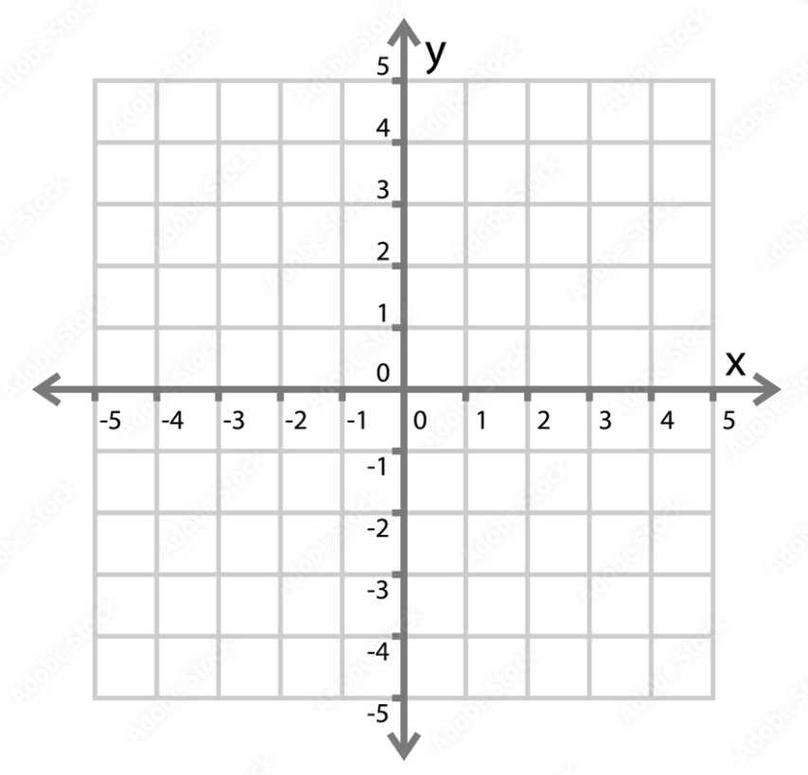


Retail example Similarity search
Product
Embeddings
Saffron Ella $2,300
Signature series
Slate Ray $2,300
Signature series
Similarity Search
Azure
OpenAI Service
Embeddings
Desk
Chair
Table
Couch
Customer
Product
Database
Embeddings Space

Slide 16







Azure OpenAI | GPT-3 sample high-level architecture
Document processing and summarization
Cosmos DB
PDF OCR pipeline
Web Application
Documents
Azure Form Recognizer
Azure Cognitive Search
Power BI
Azure OpenAI Service Summarization
Notes:
Azure Form Recognizer “cracks” documents to read handwriting, text, tables, and process language to extract entities.
Azure Cognitive Search then indexes the documents to make them searchable
Azure OpenAI Service provides a queryable interface to generate natural language summaries of the documents indexed by ACS
Cosmos DB stores the documents, document text, and outputs of OpenAI in a dynamically scalable and globally reliable database.
Results and output are then hosted on Web App (external) and Power BI (Internal)
Function Apps is utilized to call various APIs in a serverless manner to improve responsiveness and reduce costs.

Slide 17







Contact Center Analytics using Speech API & OpenAI Extract rich insights from call transcripts
Exploration
Cognitive Search
Web App
Caller
Intelligent Transcription
Interactive Search
PowerBI Insights (near real-time)
Person-to-Person Conversation
Audio Files
Azure OpenAI Service
Telephony Server
Azure Storage
Speech-to-Text
Azure Cognitive Services –
Speech & OpenAI
Conversation Trends & Insights
Call-Center Agent
CRM
Solution Accelerator
Demo Website
Detailed call history with summary, call reason, etc.

Slide 18








Azure OpenAI Virtual Assistant architecture example
Qualitative Testing App
Virtual Assistant
Azure Translator
(Non English Questions)
Azure Custom Question
Answering
(Textual Data)
Azure OpenAI Service
Technical Data
(VMDS)
Azure Machine Learning
GPT API
(Web App)
Azure SQL Database
(Technical Data)
Azure Translator
(Non English Questions)
Azure Blob Storage
Azure Custom Text
Classification
Azure Custom Named
Entity Recognition
Manuals (XML)
Azure Data Factory

Slide 19
Component descriptions
Azure Blob Storage
Stores unprocessed and processed data
The update of data triggers Azure Data Factory
Azure Data Factory
Triggering Data Pipelines
Azure Machine Learning
AML Notebooks to pre-process the data and save the outcomes to the SQL DB and Azure Custom Question Answering
Longtail Search API
Provides the API interface to the Longtail Search solution for the Virtual Assistant
Modular Architecture for scalability with application structure
Can hand over metadata to the application
Azure SQL
Stores pre-processed manuals data, API responses and user feedback
Using in-memory tables for improved performance
Azure OpenAI Service
Used to generate SQL statements and generative textual answers
Azure Custom Question Answering
Contains pre-processed data (owner manuals and component marketing texts)
Used to rank text chunks based on question
Can return confidence score of ranking result
Azure Custom Named Entity Recognition
Identify which columns are relevant to answer a user question.
CNER is a classical NLP supervised learning tool. We trained and deployed a model with user questions which can identify the relevant columns
Azure Custom Text Classification
To improve the quality of question-answering, we found out that the question classification adds a better focus. The user questions are classified into categories

Slide 20
Question answering process
User Question
Question Classification
Owners Manuals
Component Descriptions
Technical Data (VMDS)
Extract metadata from the request body
Replace model and class names (masking)
Identify relevant columns
Filtering of chunks
Build SQL Statement (Codex)
Ranking of chunks
SQL Post-Processing
Query SQL Database
Create generative answer
Generate textual output
API Response

Slide 21
Azure OpenAI Service Responsible AI
Custom content filters— tailor tone and topics to your application
Abuse detection— ensure responsible use of your application
Implementation guidelines, patterns, and best practices
Notes:
To protect against this we developed an integrated responsible AI system that uses an ensemble of models to detect problematic content like hate, sexual, violence and PII. These models can be used synchronous to improve the quality of the outputs and give customers control over the type and tone of content in their application. They can also be used to identify potential instances of abuse and alert customers of those concerns.

Slide 22
Mitigation Layers
Positioning
Product purpose
Product promises
Application
UI / UX Meta prompt
Filters
Monitoring
Rapid Response
Safety System
Model
Fine-tuning

Slide 23
RAI Mitigations
Customer
Structure user interactions. Limit the length, structure, and source of inputs and outputs
Control user access
Transparency and overreliance mitigations in UI/UX
Technical
Content Filtering
Asynchronous abuse detection
User-based throttling
User-based shutdown
Process and Policy
Limited Access
Abuse reporting channel
Feedback channel
Incident Response
Documentation and legal
Terms of use
Transparency Note
Design Guidelines

Slide 24
Quality Harm to individuals or businesses due to unintended outputs or overreliance
Incident Class Shorthand | Incident Class Extended Description
Inaccurate Text | API generates misleading, inaccurate, or poorly-contextualized content on high-stakes topics
Incorrect/insecure code | API generates incorrect or insecure code that is used unknowingly by users
PII | API generates responses that contain email addresses, SSNs, and other PII that is
Proprietary Info/plagiarism | API generates based on content or code that is proprietary
Demeaning, stereotyping, hate | API generates content that is offensive toward members of social groups
Inequitable allocation | API outputs lead to inequitable allocation of resources (e.g., likelihood of receiving job interview based on automated resume screener)
Quality of service harms | API systematically performs worse on text by, for, and about different social groups
Violence or Self-Harm | API instructs, affirms, or radicalizes a human to commit direct harm to themself or others
Profane, sexual, inappropriate, or sensitive content | API generates contextually inappropriate, offensive, or sensitive content

Slide 25

Safety Execution Workflow
People & Policy
Detect |
RAI Safety Architecture
Review |
Human Review
Act |
Decision
Application
Prompt
....
Customer Application
AOAI Endpoint
PII
Yes
Yes
User/Account Actions
RAI Model Ensemble
Sexual
Investigation Needed?
Abuse
Concern
Hate
Action Needed?
Filtered Response
Filtering Concerns
Filter
Improvement
RAI Logs
Alert
No
No
Notes:
We are deeply investing in this area and in the continuous improvement of the AI systems. We use humans today but a key part of that is for us to learn how to do this automatically in the future.

Slide 26

Azure OpenAI Service Responsible AI
Prompt
Content MGMT
Customer Application
Filtered Response
Content filtering— can filter out abuse and misuse
Content Management
Implementation guidelines, patterns, and best practices
....
Sexual
Hate

Slide 27
Safety Execution Flow
System/Tech Improvement Loop
Tech
People & Policy
Application
Prompt
....
Customer Application
AOAI Endpoint
RAI Model Ensemble
PII
Yes
Yes
User/Account Actions
Sexual
Investigation needed?
Abuse
Concern
Hate
Detect |
RAI Safety Architecture
Review |
Human Review
Action needed?
Act |
Decision
Filtered Response
Filtering Concerns
Filter
Improvement
RAI Logs
Alert
No
No
Appeals
Appeal
Throttling
Appeal
Suspension
User Reports
Report Abuse
Report Filter Issue
Data Labeling for Enrichment
Sampling
RAI System Improvements
Metrics
Understand | Continuous Improvements
External Report
Article Finds Issue
Study Finds Issue
Policy & Standards
Limited Access
RAI Guidance
Code of Conduct
Supporting Operations Procedures
Policy & Governance

Slide 28
Safety Execution Flow
System/Tech Improvement Loop
Tech
People & Policy
MBO functions
Detect |
RAI Safety Architecture
Review |
Human Review
Act |
Decision
Application
Prompt
....
Customer Application
AOAI Endpoint
RAI Model Ensemble
PII
Yes
Yes
User/Account Actions
Sexual
Investigation needed?
Abuse
Concern
Hate
Action needed?
Filtered Response
Filtering Concerns
Filter
Improvement
RAI Logs
Alert
No
No
Appeals
Appeal
Throttling
Appeal
Suspension
Understand | Continuous Improvements
User Reports
Report Abuse
Report Filter Issue
Data Labeling for Enrichment
Sampling
RAI System Improvements
Metrics
External Report
Policy & Governance
Article Finds Issue
Study Finds Issue
Policy & Standards
Limited Access
RAI Guidance
Code of Conduct
Supporting Operations Procedures

Slide 29
Responsible AI resources
Content filtering: https://learn.microsoft.com/en-us/azure/cognitive-services/openai/concepts/content-filter
Responsible AI resources (aka.ms/RAIResources)
Human and AI Interaction Toolkit (https://www.microsoft.com/en-us/haxtoolkit/workbook/)
Management tools

Slide 30
Evaluating and integrating Azure OpenAI for your use Practices for responsible use
Ensure Human Oversight | Let people edit generated outputs. Highlight potential inaccuracies in generated outputs. Remind uses that they are accountable for final decisions and/or final content. Limit how people can automate your product or service.
Implement technical limits on inputs and outputs | Limit the length of inputs and outputs. Structure inputs to limit open-ended responses and to give users more refined control. Return outputs from validated, reliable source materials. Implement blocklists and content moderation. Put rate limits in place.
Authenticate Users | To make misuse more difficult, consider requiring that customers sign in and, if appropriate, link a valid payment method. Consider working only with known, trusted customers in the early stages of development. Applications that do not authenticate users may require other, stricter mitigations to ensure the application cannot be used beyond its intended purpose.
Test your application thoroughly | Conduct adversarial testing where trusted testers attempt to find system failures, poor performance, or undesirable behaviors. Understand risks and consider appropriate mitigations. Communicate the capabilities and limitations to stakeholders.
Establish Feedback Channels for users and impacted groups | Build feedback features into the user experience. Publish an easy-to-remember email address for public feedback.
Notes:
Learn more here: https://learn.microsoft.com/en-us/legal/cognitive-services/openai/transparency-note?context=%2Fazure%2Fcognitive-services%2Fopenai%2Fcontext%2Fcontext#practices-for-responsible-use

Slide 31
Evaluating and integrating Azure OpenAI for your use Scenario-specific practices
If your application powers chatbots or other conversational AI systems | Follow the Microsoft guidelines for responsible development of conversational AI systems
If you are developing an application in a high-stakes domain or industry | In healthcare, human resources, education, or the legal field, thoroughly assess how well the application works in your scenario, implement strong human oversight, thoroughly evaluate how well users understand the limitations of the application, and comply with all relevant laws. Consider additional mitigations based on your scenario.
Learn more here on our website

Slide 32
API usage/rate limits
Requests per second per model | 120 requests per minute* for: Davinci-models (002 and later) 300 requests per minute* for all other models.
Tokens per minute per model | 40K tokens per minute* for: Davinci-models (002 and later) 120K tokens per minute* for all other models.
*all rate limits and availabilities are subject to change. Increased quotas can be requested, but not guaranteed. Learn more.

Slide 33
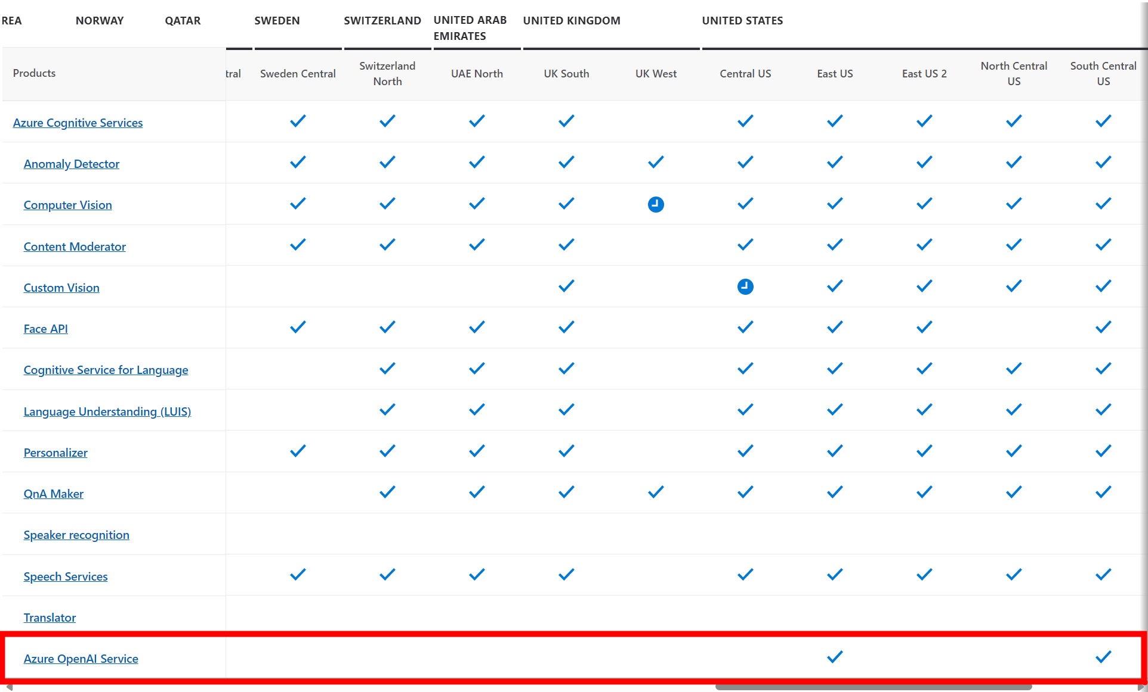
Region availability
Regions currently available at launch:
East US
South Central US
West Europe
To see the list of available regions, please visit: Product available by region

Slide 34
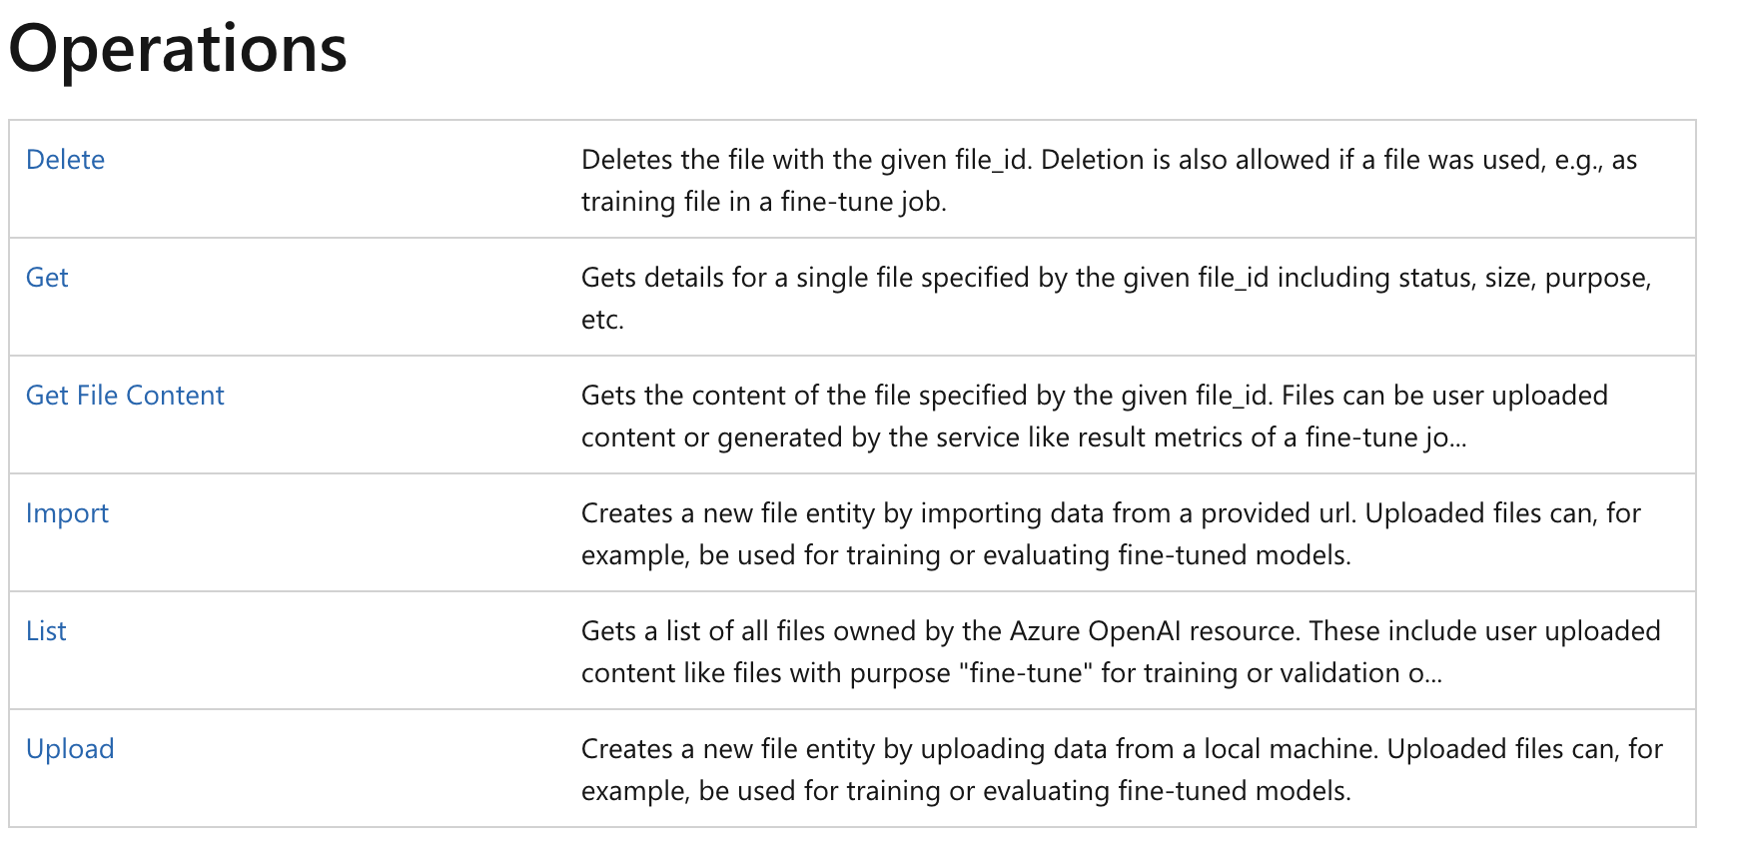
REST API | Reference
Azure OpenAI REST API reference—Azure OpenAI | Microsoft Learn

Slide 35
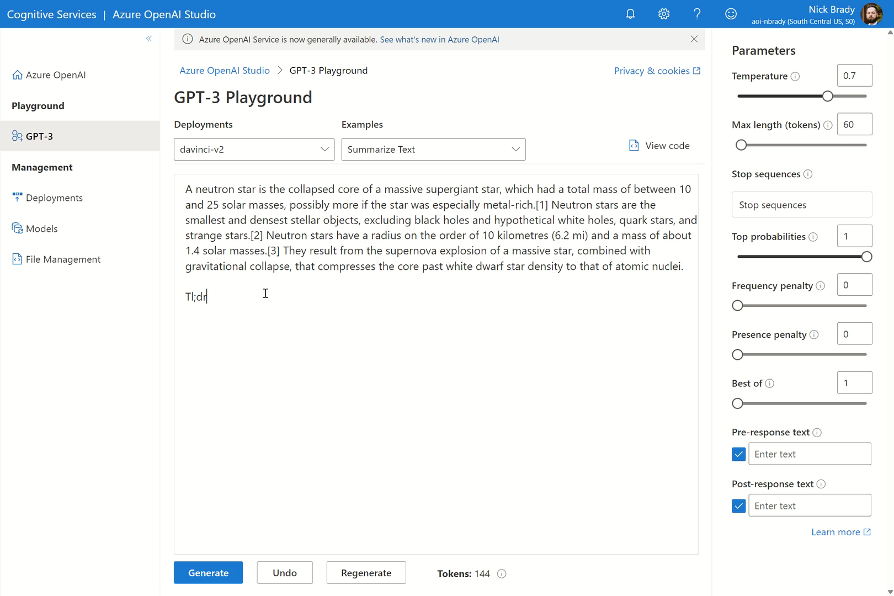
Azure OpenAI Studio Getting started
Get started in the Studio
Refine your prompt
Copy your code

Slide 36
What data does the Azure OpenAI Service process?
Azure OpenAI processes the following types of data:
Text prompts, queries, and responses submitted by the user via the completions, search, and embeddings operations.
Training and validation data. You can provide your own training data consisting of prompt-completion pairs for the purposes of fine-tuning an OpenAI model.
Results data from training process. After training a fine-tuned model, the service will output meta-data on the job which includes tokens processed and validation scores at each step.

Slide 37
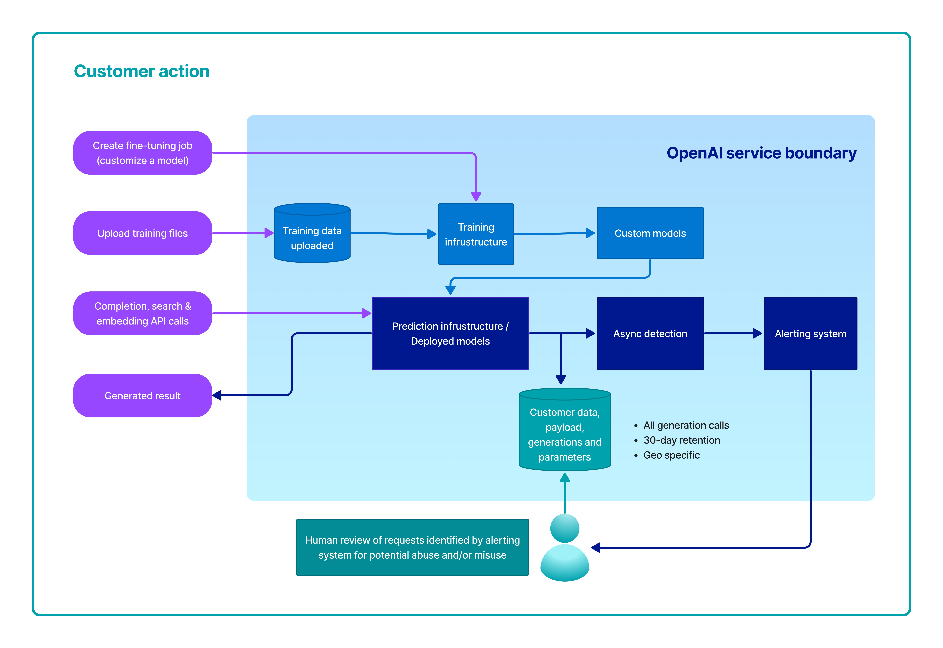
How Azure OpenAI processes data
Notes:
This diagram illustrates how your data is processed. This diagram covers three different types of processing:
How the Azure OpenAI Service creates a fine-tuned (custom) model with your training data
How the Azure OpenAI Service processes your text prompts to generate completions, embeddings, and search results; and
How the Azure OpenAI Service and Microsoft personnel analyze prompts & completions for abuse, misuse or harmful content generation.

Slide 38
Training data to fine-tune an OpenAI model
The training data (prompt-completion pairs) submitted to the Fine-tunes API through the Azure OpenAI Studio is pre-processed using automated tools for quality checking including data format check.
The training data is then imported to the model training component on the Azure OpenAI platform.
During the training process, the training data are decomposed into batches and used to modify the weights of the OpenAI models.
Training data provided by the customer is only used to fine-tune the customer’s model and is not used by Microsoft to train or improve any Microsoft models.

Slide 39

Text Prompts to generate completions, embeddings and search results
Once a model is deployed, you can generate text using this model using our Completions operation through the REST API, client libraries or Azure OpenAI Studio.
Notes:
Text prompts to generate completions, embeddings and search results
Once a model is deployed, you can generate text using this model using our Completions operation through the REST API, client libraries or Azure OpenAI Studio.

Slide 40

Abuse and harmful content generation
The Azure OpenAI Service stores prompts & completions from the service to monitor for abusive use and to develop and improve the quality of Azure OpenAI’s content management systems. Learn more about our content management and filtering.
Authorized Microsoft employees can access your prompt & completion data that has triggered our automated systems for the purposes of investigating and verifying potential abuse; for customers who have deployed Azure OpenAI Service in the European Union, the authorized Microsoft employees will be located in the European Union.
This data may be used to improve our content management systems.
In the event of a confirmed policy violation, we may ask you to take immediate action to remediate the issue to and to prevent further abuse.
Failure to address the issue may result in suspension or termination of Azure OpenAI resource access.
A customer can opt out of logging and human review process—learn more here.
Notes:
A customer can opt out of logging and human review process as set forth in https://learn.microsoft.com/en-us/legal/cognitive-services/openai/data-privacy
The Azure OpenAI Service stores prompts & completions from the service to monitor for abusive use and to develop and improve the quality of Azure OpenAI’s content management systems. Learn more about our content management and filtering. Authorized Microsoft employees can access your prompt & completion data that has triggered our automated systems for the purposes of investigating and verifying potential abuse; for customers who have deployed Azure OpenAI Service in the European Union, the authorized Microsoft employees will be located in the European Union. This data may be used to improve our content management systems.
In the event of a confirmed policy violation, we may ask you to take immediate action to remediate the issue to and to prevent further abuse. Failure to address the issue may result in suspension or termination of Azure OpenAI resource access.

Slide 41

Training, validation, and training results data
The Files API allows customers to upload their training data for the purpose of fine-tuning a model.
This data is stored in Azure Storage, encrypted at rest by Microsoft Managed keys, within the same region as the resource and logically isolated with their Azure subscription and API Credentials.
Uploaded files can be deleted by the user via the DELETE API operation.
Notes:
Training, validation, and training results data. The Files API allows customers to upload their training data for the purpose of fine-tuning a model. This data is stored in Azure Storage, encrypted at rest by Microsoft Managed keys, within the same region as the resource and logically isolated with their Azure subscription and API Credentials. Uploaded files can be deleted by the user via the DELETE API operation.

Slide 42


STRABAG
The margins in construction are narrow, so it’s important for companies to pick the right projects to work on.
Strabag SE used Azure OpenAI Service to build an AI-based risk management solution that assesses which construction projects might fail – therefore minimizing the risks that come with it and saving time and money.
“With just three months of data, this algorithm can predict risk with 80% accuracy – it’s mind-blowing!”
- Dr. Marco Bornschlegl, Head of Innovation and Digitalisation
Strabag SE
Notes:
https://customers.microsoft.com/en-us/story/1596825960615628483-strabag-discrete-manufacturing-azure-en-austria

Slide 43


CARMAX
Since 1993, CarMax has grown from an industry-disrupting startup to become the United States’ leading used car retailer.
CarMax uses Azure OpenAI Service to streamline the creation of text summaries for its car research pages, quickly providing customers with meaningful content that also boosts the pages’ search engine rankings.
“With the help of OpenAI Service, we’re disrupting our industry for a second time by delivering cutting-edge digital tools and capabilities and becoming a true omnichannel retailer.”
Shamim Mohammad, Executive Vice President and Chief Information and Technology Officer
CarMax
Notes:
https://customers.microsoft.com/en-us/story/1501304071775762777-carmax-retailer-azure-openai-service

Slide 44


TRELENT
Trelent uses cutting-edge AI algorithms to provide intelligent source code documentation for its clients.
To scale its solution and accommodate the data security and residency needs of enterprise customers around the globe, Trelent chose to migrate its solution to Microsoft Azure OpenAI Service.
“With a product like OpenAI Service behind you, you can focus a lot more on what really matters, which is delivering a great experience, a great product, and a lot of value to your customers.”
Calum Bird, CEO
Trelent
Notes:
https://customers.microsoft.com/en-us/story/1549838968222249829-trelent-azure-openai-service

